Slide 1
Twitter US Airline Sentimental Analysis
Dissertation Presentation
Module Supervisor:Mike kretsis
Module Code:CN7000
Student Name: Konduri Varun Kumar

Slide 2
Introduction
A valuable tool for almost real-time marketing, public opinion, and customer knowledge mining in conjunction with the brands Twitter and other microblogging services. The research on automated sentiment analysis focuses therefore upon the compilation and analysis of natural language content created by users. The most successful approach is mastered machine learning, which includes data cleaning and transformation, the generation of features and the choice of model and the selection of parameters. Documents have been extensively reviewed in recent years and it is understood that relatively simple techniques such as textual conversion and Naive bayes models can produce acceptable results and good tuning can be difficult, producing relatively limited results (75 percent to 85 percent F1 scores for the average dataset). But even with a mid-sized dataset, many percentage levels of success can mean thousands of better classified materials, meaning thousands of lost or unhappy customers in any business sector. In the existing data sets of 6 US airlines we have tweets and we have to predict whether the tweets are positive, negative or neutral. It is a standard supervised job, where a problem statement is given to us and categorized into a predetermined category. Experiments show Naive Bayes, logistic regression, decision tree classification, random forest, KNN classifiers with domain specific terminals, and check whether the data has not been imbalanced or whether the groups are not binary. To improve the predictive efficiency, filtering stopwords is crucial; and the experiment shows that a collection of stopwords should be domain specific. The inference is that in sentiment analysis, there is no optimal way to model training and stopword collection. This paper therefore suggests that a comparison framework can be used to fine tune prediction trends for a given problem: a comparison framework can compare various training settings on the same data set so that the best trained models for a given real-life problem can be identified.

Slide 3
Aim
Twitter data mining is a relatively well-known area in natural language analysis and emotion perception, with many industrial uses. Machine learning algorithms that produce results using very easy approaches and can be used for testing problems and even real-life construction environments seem to be ideal for Twitter info. Since these technologies provide organisations with useful knowledge, it is critical that they are implemented properly and effectively.
The volume of knowledge gathered from microblogging platforms like Twitter has skyrocketed. Because of its significance, even a small improvement in the productivity of applications would yield significant value thanks to sentiment-based analysis. As a result, diverse industry applications and special areas necessitate changing the model. As a result, the alteration of this model work is contrasted. Proposals are used for the data collection of Airlines in this work after evaluating previous work on the subject and suggesting more promising alternatives (which is described in The Dataset section). A second dataset is used to ensure that not just one but still sufficiently broad data sets are gathered. The work is given a comparative context that explains the implementation and optimization of models. Has the study query, "How do I automatically, modularly, and easily select features in order to evaluate various models in Twitter analysis?" been asked in this research?

Slide 4
Literature Review
Twitter data is extensively investigated, as Twitter is an open source of useful information. The early papers on Twitter data sentiment analysis were published around 2009. Twitter provides public APIs with different data collection capabilities (but the public API is also becoming more and more limited because it also sees value). However, for sentiment analysis, there are a wide number of publicly accessible datasets. In documents on sentiment analysis, in particular about Twitter data, the following is a popular pattern.
Linguistic and replacement methods (Dave, Kushal and Pennock, 2003) To transform Ngram. 'The simplest feature for Twitter sentiment analysis is Word N-grams functions' (Jianqiang et al, 2017). There's a variety Opinions on the ideal n-gram dimensions; this thesis argues that Possibly the data set and the domain are used for the environment.
Conversion to POS (Speech Part). '[These] methods have shown that POS tags are accurate. Intuition is that such POS tags are strong indicators of feelings (Wiebe and Riloff, 2005)

Slide 5
Literature Review
Recognition of text patterns (POS groups, syntactic trees..) The approaches focused on semantics and syntax. Those strategies are traditionally focused on language studies such as 'Contextual semantic approaches', 'Conceptual semantic approaches' and 'Entity-Level Sentiment Analysis Approaches' (Saif, Francis and Alani, 2016). The main emphasis of these works is the personalized implementation. In the experiment, the authors show that the features proposed work effectively and can produce an improved prediction on the dataset. A base score is always provided in the assessment section, and almost always the outcome exceeds the base score. The assessment may be a simple score, uncertainty matrix, F1 score, or other metrics like accuracy and reminder (Jianqiang and Xiaolin, 2017). Machine learning techniques are the state of the art in the area, but most of the papers concentrate on the function output portion. Most papers identify the algorithms used, and compare the results between different algorithms (Dave, Kushal and Pennock, 2003), (Jianqiang and Xiaolin, 2017). But most reviews do not detail the algorithms (parameters, Deployments, etc..)

Slide 6
Simulation Framework
Step 1: Download the data from Kaggle and load the Data on Google colaboratory.
Step2: Import all required Python packages.
Step3: Data preprocessing for understanding the data in depth most before the sentimental analysis.
Step4: Visualise the data graphically.
Step5: Build the Machine learning models such as Decision tree, Logistic Regression, Random Forest, KNN and get their classification report.
Step6: Compare the results with your Literature work made by previous researcher.
Step7: Give the future work for better building the model.

Slide 7
Proposed Solutions
My recommendation is to build the several classifiers are as follows:
1. Supervised Learning.
2. Unsupervised Learning.
3. Semi Supervised learning.
4. Reinforcement learning.
5. Logistic regression.
6. Application from Naive Bayes
7. Decision Tree algorithm:
8. Random Forest.
9. K Nearest Neighbour.

Slide 8
Methodology
This data set has been taken from Kaggle [www.kaggle.com, 11/5/2016],It has 14640 rows and 15 columns.
In this method we have used various methods to obtain the results which are different from the literature review.
Twitter data mining is a relatively well-known area in natural language analysis and emotion perception, with many industrial uses. Machine learning algorithms that produce results using very easy approaches and can be used for testing problems and even real-life construction environments seem to be ideal for Twitter info. Since these technologies provide organisations with useful knowledge, it is critical that they are implemented properly and effectively.
POS has been classified with the emotions.
STOP WORDS has been classified with word count.

Slide 9
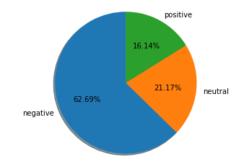
Percentage of emotions
After importing the python libraries we will figure out the emotions percentage in the following pie chart :

Slide 10
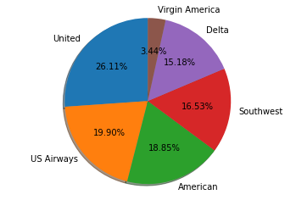
Tweets on each airline
Tweets on different air lines are shown in the pie chart.

Slide 11
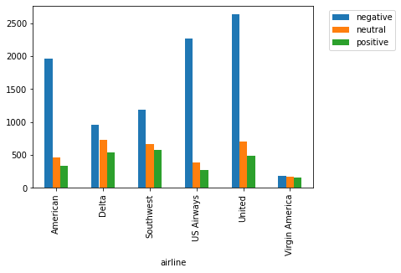
Sentiment on tweets
How many of these tweets per airline are negative, positive and neutral are demonstrated in the mat plot lib

Slide 12
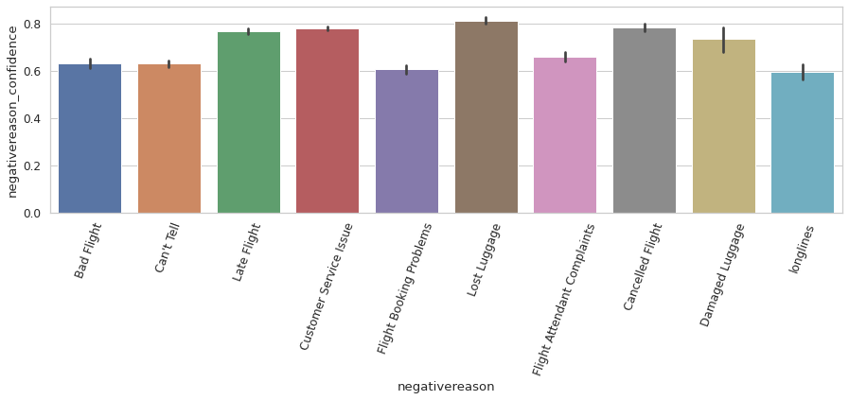
Reason for Tweet
Due to various reasons passengers have tweet the airlines the results are shown in the image:

Slide 13
Accuracy Scores
Logistic Regression
The accuracy score of the logistic regression was 79.1% which is good, this algorithm predicts the emotions of the tweets.
Multinomial Naïve Bayes:
MultinomialNB Accuracy Score is 69.69%.
 | Precision | Recall | F1-score
Negative | 0.93 | 0.81 | 0.87
Neutral | 0.48 | 0.66 | 0.56
Positive | 0.60 | 0.81 | 0.69
Accuracy |  |  | 0.79
Macro Avg | 0.67 | 0.76 | 0.71
Weighted Avg | 0.83 | 0.79 | 0.80
 | Precision | Recall | F1-score
Negative | 0.99 | 0.69 | 0.81
Neutral | 0.15 | 0.78 | 0.26
Positive | 0.18 | 0.93 | 0.31
Accuracy |  |  | 0.70
Macro Avg | 0.44 | 0.80 | 0.46
Weighted Avg | 0.94 | 0.70 | 0.77

Slide 14
Accuracy
Decision Tree Algorithm:
Decision Tree Classifier Accuracy score is 67.42%.
Random Forest:
Random Forest Classifier accuracy score is 76.78%.
 | Precision | Recall | F1-score
Negative | 0.79 | 0.78 | 0.79
Neutral | 0.40 | 0.41 | 0.40
Positive | 0.55 | 0.57 | 0.56
Accuracy |  |  | 0.67
Macro Avg | 0.58 | 0.58 | 0.58
Weighted Avg | 0.68 | 0.67 | 0.67
 | Precision | Recall | F1-score
Negative | 0.94 | 0.79 | 0.86
Neutral | 0.38 | 0.63 | 0.48
Positive | 0.54 | 0.79 | 0.64
Accuracy |  |  | 0.77
Macro Avg | 0.62 | 0.74 | 0.66
Weighted Avg | 0.83 | 0.77 | 0.79

Slide 15
Accuracy
K Nearest Neighbour Classifier:
KNeighbors Classifier accuracy score is 69.83%.
 | Precision | Recall | F1-score
Negative | 0.82 | 0.80 | 0.81
Neutral | 0.46 | 0.42 | 0.44
Positive | 0.53 | 0.65 | 0.58
Accuracy |  |  | 0.70
Macro Avg | 0.60 | 0.62 | 0.61
Weighted Avg | 0.70 | 0.70 | 0.70

Slide 16
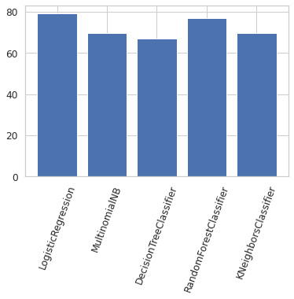
Image Representation
Result has been obtained by all the classifiers such as Logistic regression, Navies Byes, K nearest neighbour classifier, random forest classifier and decision tree classifiers and finally among all these algorithms logistic regression achieved the high accuracy with 79.1% and also precision and recall score are also high compared to other algorithms. And secondly random forest got a good accuracy of 76.69% which is similar to the logistic regression accuracy, here the precision score, recall and F1-score are also quite good. And remaining algorithms such as Multinomial NB classifiers, Decision tree and KNN got similar accuracy and these are not reached to the 70% and also the score for the classification report are also quite low. Among all these algorithms I felt logistic regression is the best one with good accuracy.

Slide 17
THANKING YOU

